Slide 1
Hospital Management System
By: Amjad Al-Tarefe
amjadaltarefy@gmail.com

Slide 2
Overview
This is a system designed to allow the user to enter the information of doctors, nurses and patients. It also allows the user to edit and print all the information of a single person, or edit and print them individually.

Slide 3
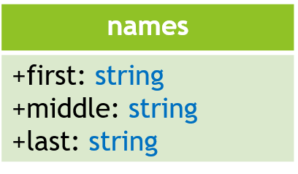
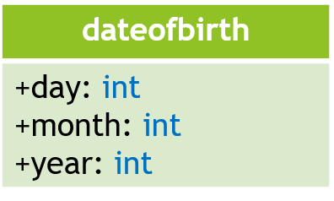
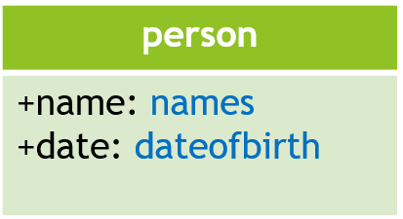
Structs and person class:

Slide 4
Hospital
Doctor
Nurse
Patient

Slide 5
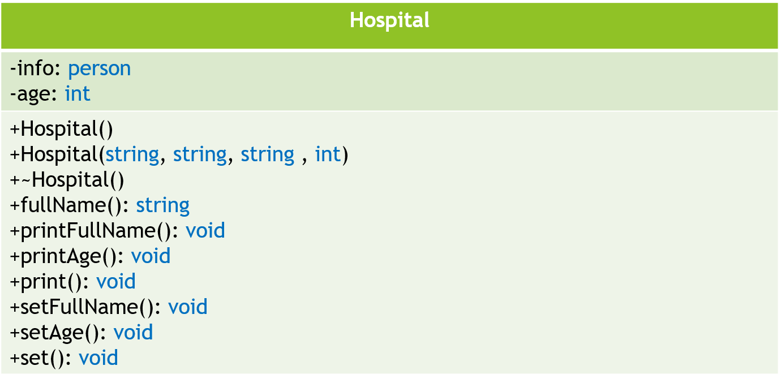

Slide 6
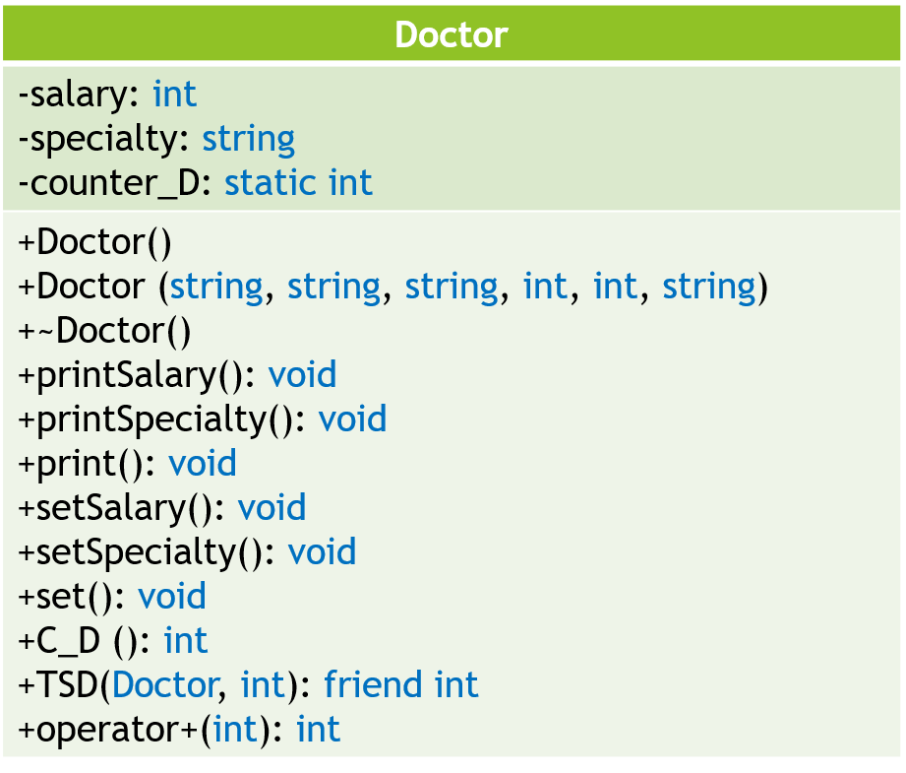
Hospital
Doctor

Slide 7
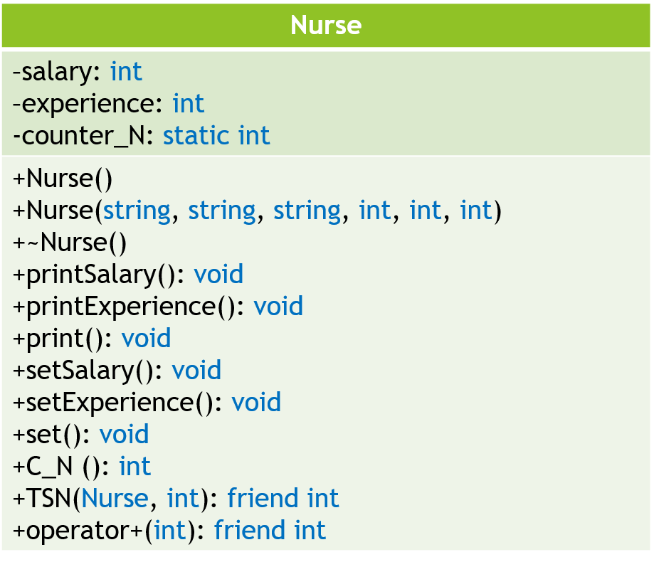
Hospital
Nurse

Slide 8
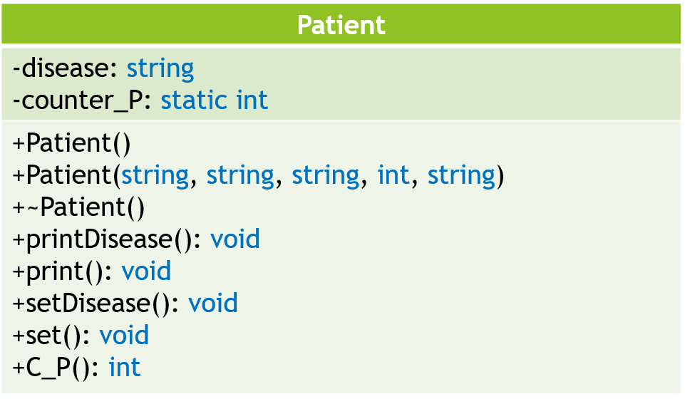
Hospital
Patient

Slide 9
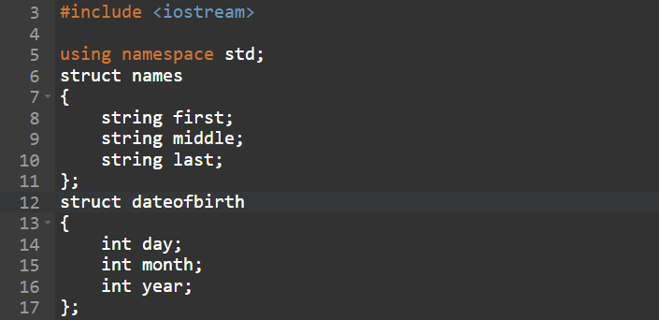
Structs

Slide 10
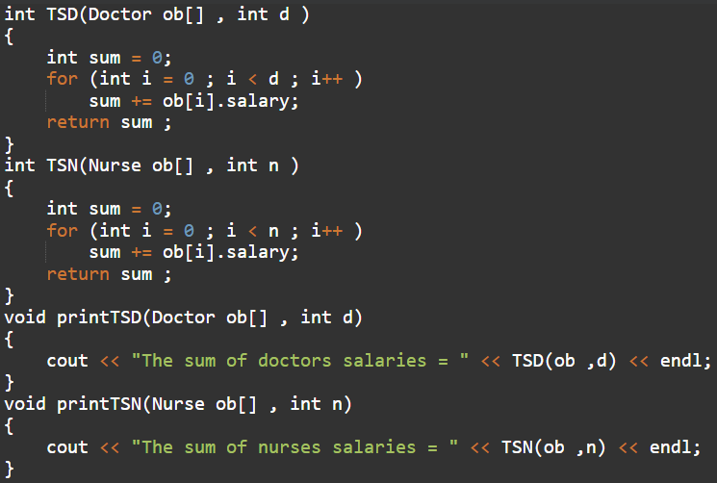
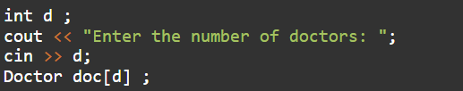

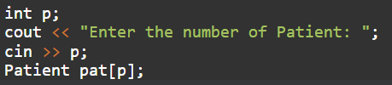
Array:

Slide 11
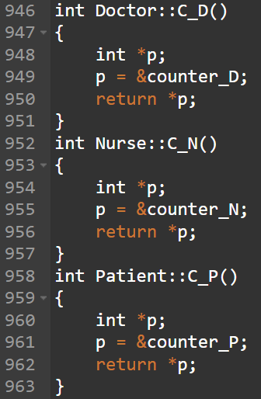
Pointers:

Slide 12
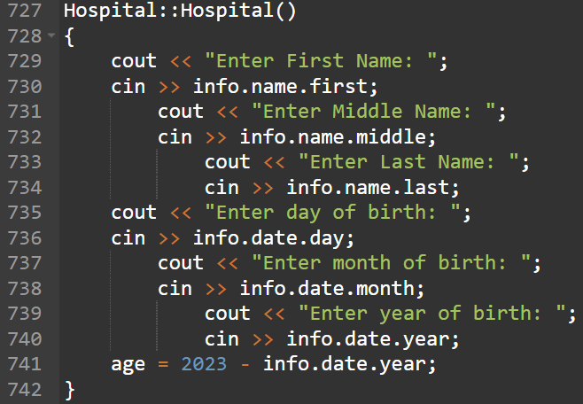
Default Constructer:
This same format was also used for the Nurse and patient classes.

Slide 13
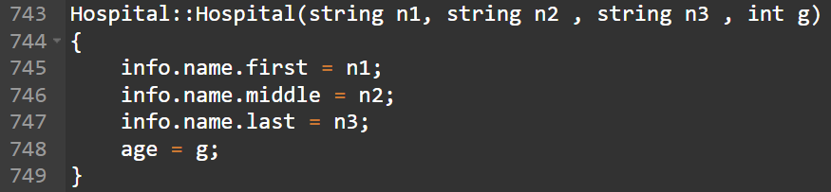
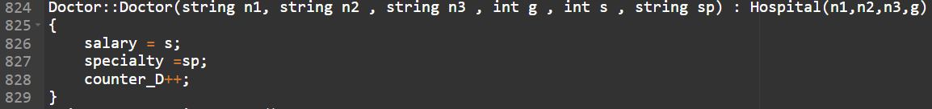
Parameter Constructer:
This same format was also used for the Nurse and patient classes.

Slide 14



Destructors:

Slide 15
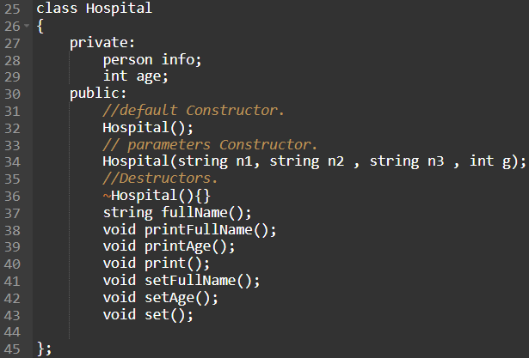
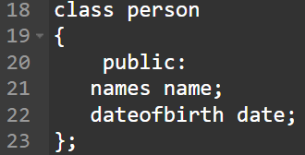
Composition:

Slide 16
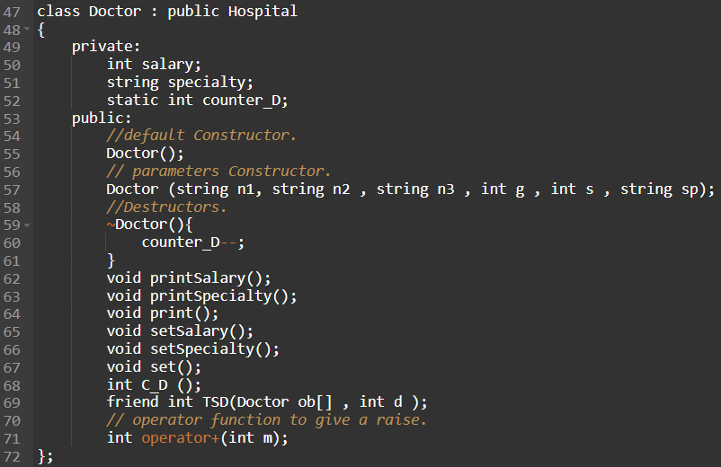
Inheritance:

Slide 17
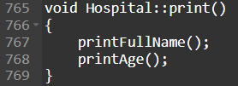
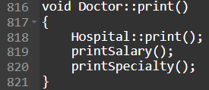
Overriding Function:
print function in base class Hospital.
print function in derived class Doctor.

Slide 18
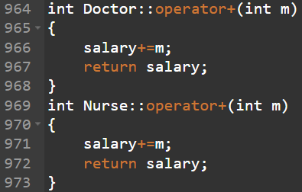


Overloading:

Slide 19


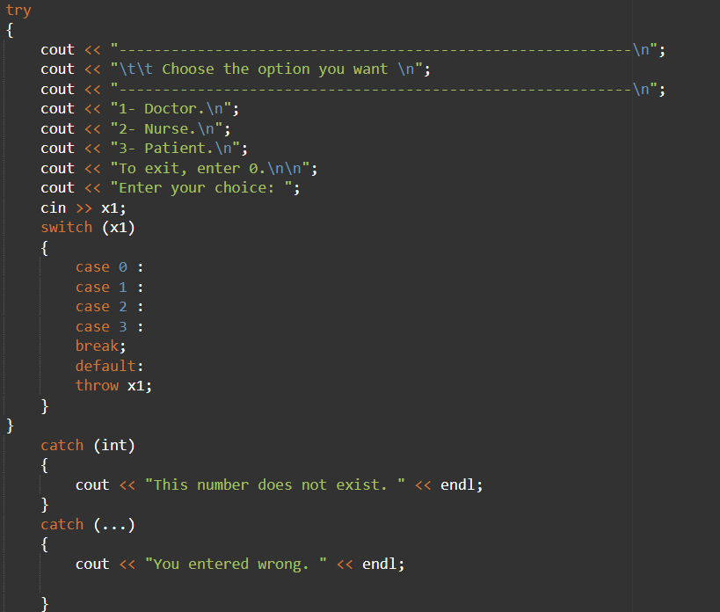

Exception Handling:

Slide 20
Thank you for your time.

